Slide 1

STOCK PRICE PREDICTION
PRESENTEND BY,
JAYAKRISHNAN SUNIL KUMAR
KIZHAKEPURA VELAYUDHAN GEEDHU
PAULRAJ JEMIMA
SANTHIRAVATHANAN DELAXSHANA

Slide 2

OBJECTIVE
Illustrate the complete stock price forecasting process by integrating yfinance data from Google, Apple, and NVIDIA into the Google Cloud Platform using Big Query.
Apply LSTM (Long Short Term Memory), Linear Regression, and Moving Average algorithms to forecast stock prices.
Determine the optimal algorithm among the three and identify the leading stock market company.

Slide 3
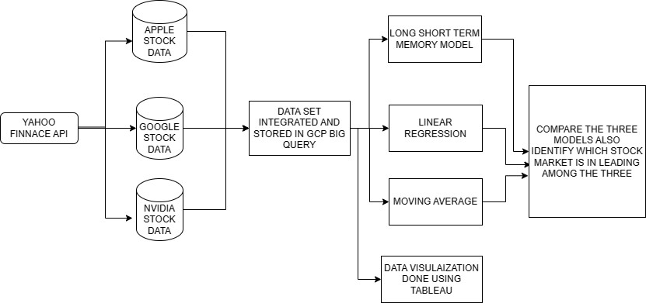
MODEL

Slide 4
DATA RESEARCH AND INTEGRATION
Data collected from yahoo finance (yfinance) API.
Three companies:
Google (GOOGL)
Apple (APPL)
NVIDIA (NVDA)

Slide 5
DATA RETRIEVED FOR EACH COMPANY: KEY FEATURES
Date
Open
High
Low
Close
Adjacent(Adj) Close
Volume
Stock [Added an extra column for company identification during merging.]

Slide 6

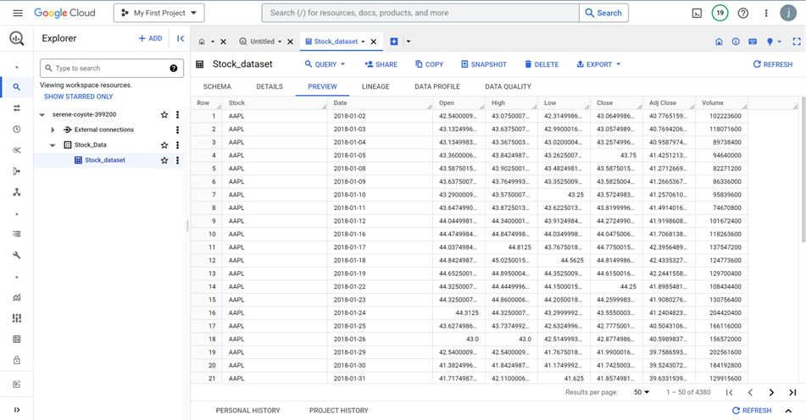
DATA STORAGE AND MAINTENENACE
All three companies’ stock market data have been collected for the past five years and are integrated and stored using Big Query in Google Cloud Platform.

Slide 7
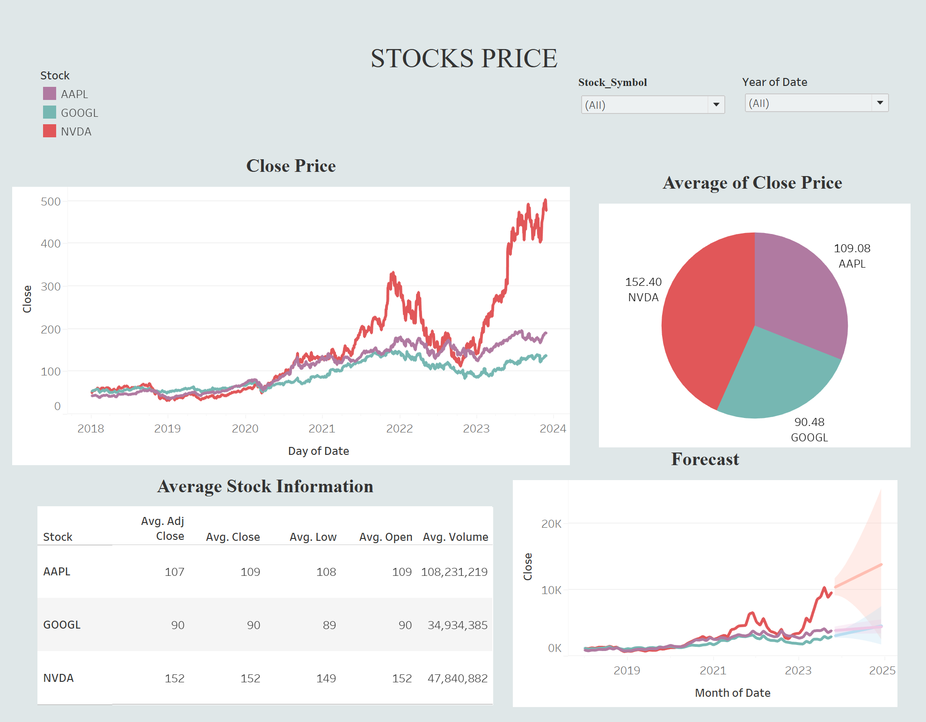
Data Exploration and Visualize

Slide 8
MACHINE LEARNING ALGORITHM USED
LINEAR REGRESSION MODEL
MOVING AVERAGE MODEL
LONG SHORT - TERM MEMORY MODEL

Slide 9
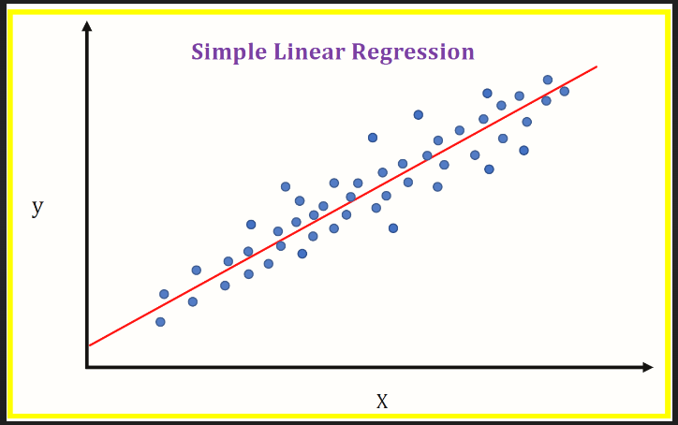
LINEAR REGRESSION MODEL
The linear regression model returns an equation that determines the relationship between the independent variables and the dependent variable.
In this model :
Used Date column as Index.
Extracting Days from the Date column. (Independent Variable)
‘Close’ column is the target Value. (Dependent Variable)

Slide 10
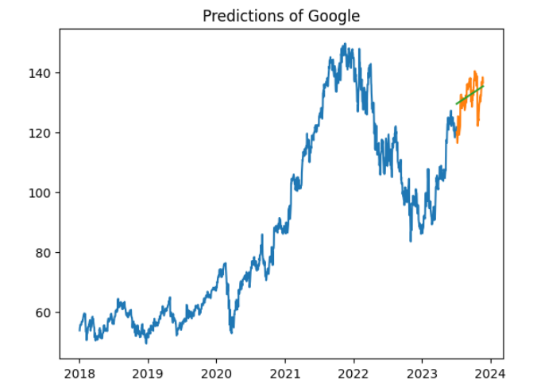
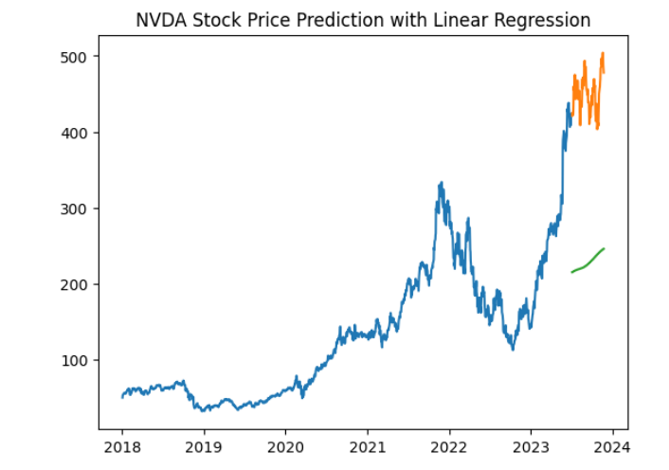
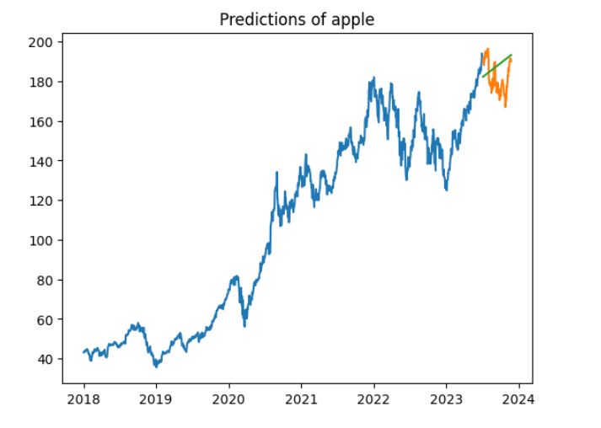
Predictions of 3 companies using
linear regression

Slide 11
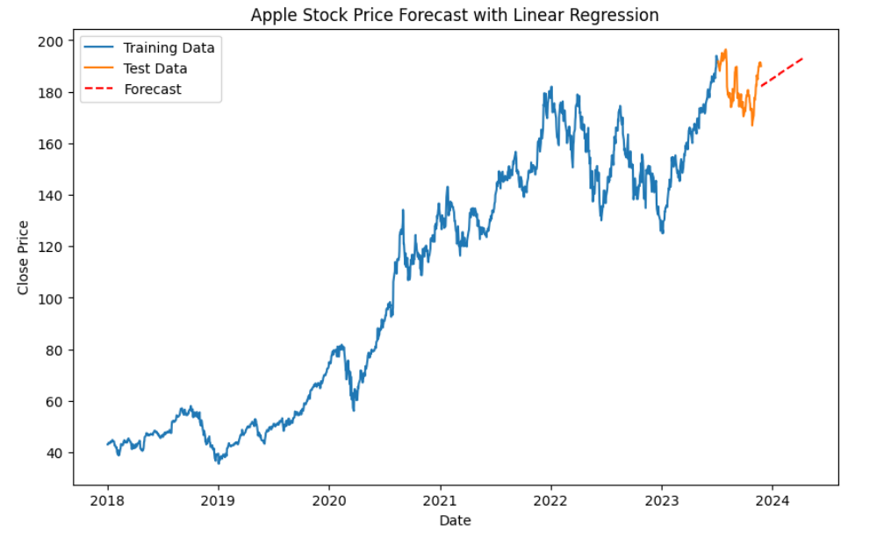
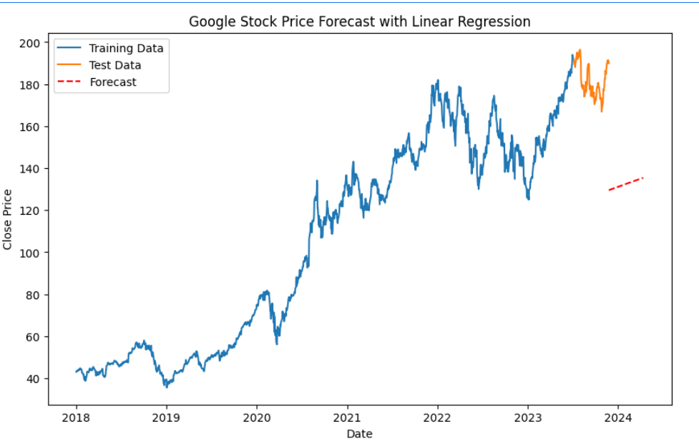
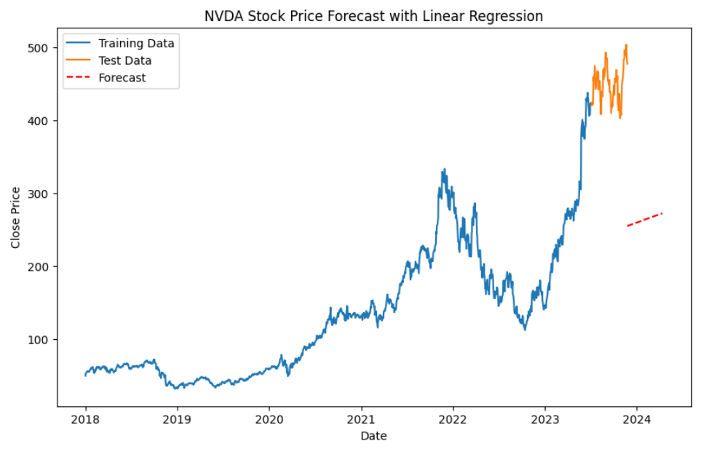
Forecasting of 3 companies using linear regression

Slide 12
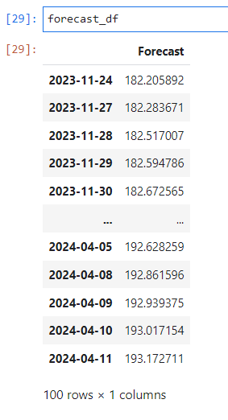
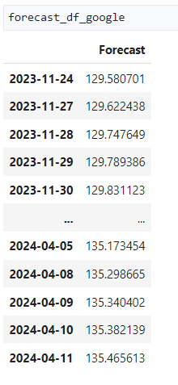
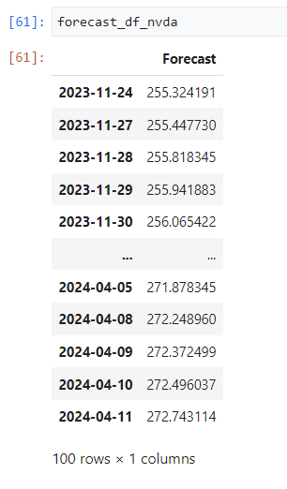
Forecasted values for next 100 days

Slide 13
RSME (Root mean squared error) values
rms = np.sqrt(np.mean(np.power((y_test- predictionsLM), 2)))
Apple : 11.342481602316933
Google: 5.187067710161403
NVDA: 188.02634665726174

Slide 14
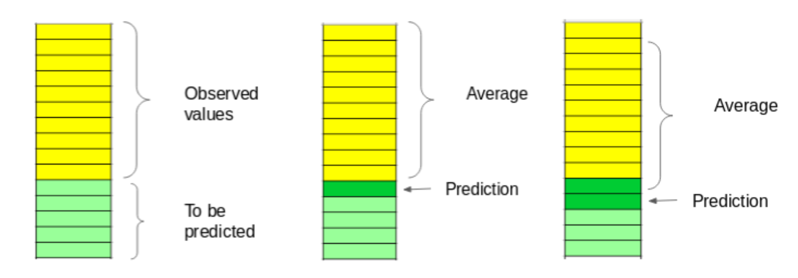
MOVING AVERAGE ALGORITHM
A quantitative method of forecasting or smoothing a time series by averaging each successive group (number of observations) of data values.
The term “Moving” is used because it is obtained by summing and averaging the values from a given number of periods, each time deleting the oldest value and adding a new value.

Slide 15
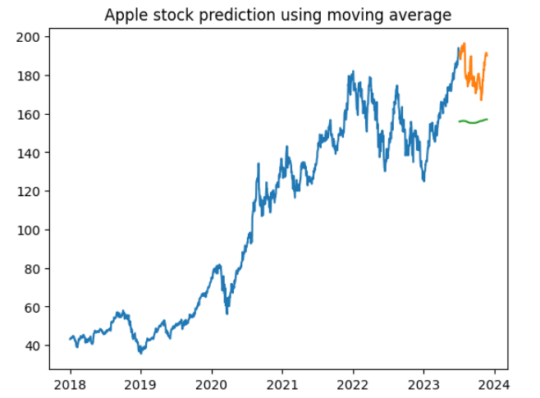
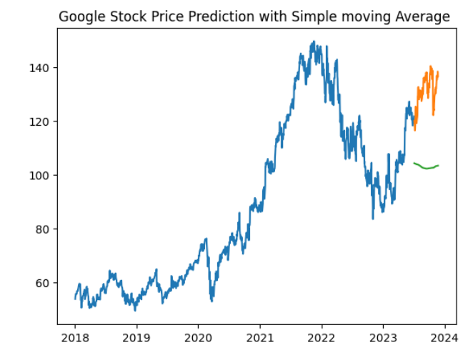
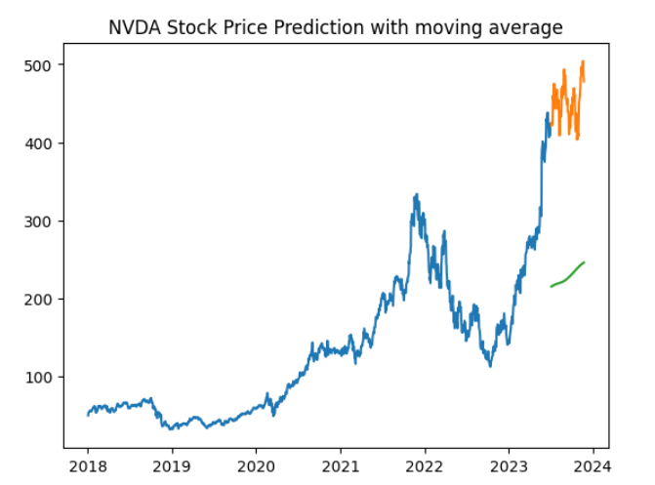
Predicted Output using moving average

Slide 16
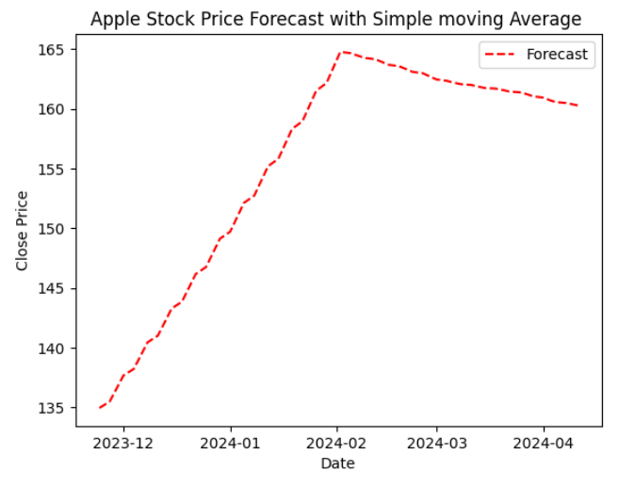
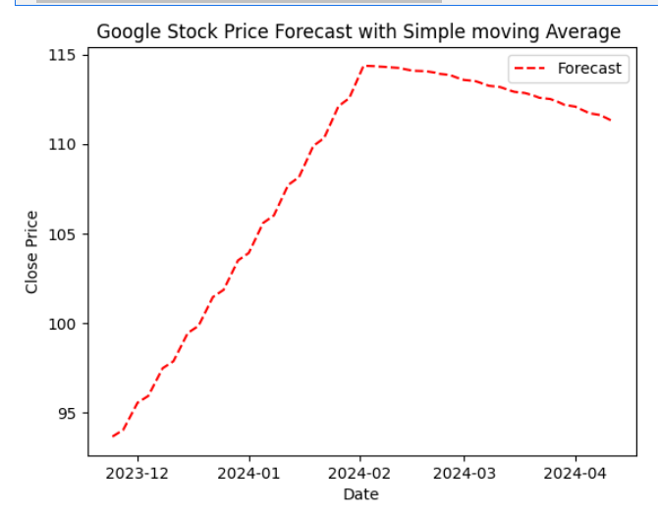
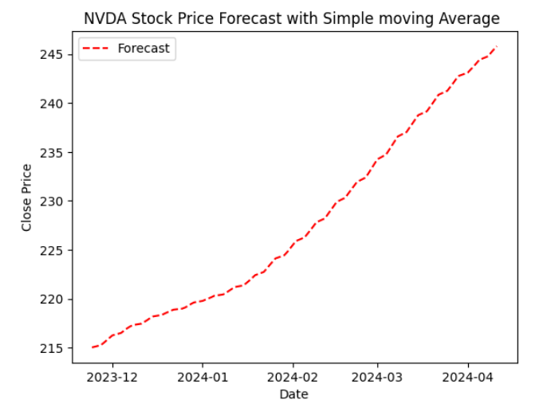
Forecasted Output using moving average

Slide 17
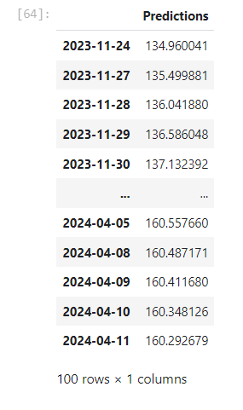
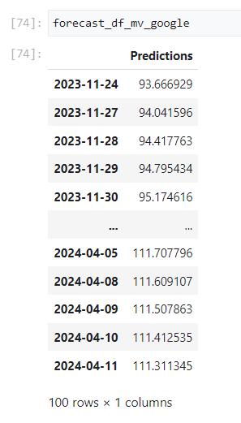
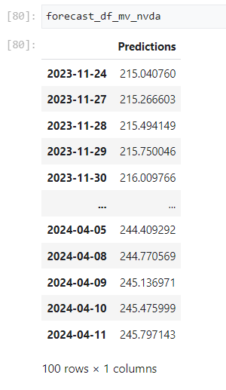
Forecasting values for next 100 days

Slide 18

RSME (Root Mean Squared Error) values
Apple : 26.80430
Google: 28.89036
NVDA: 223.9280

Slide 19
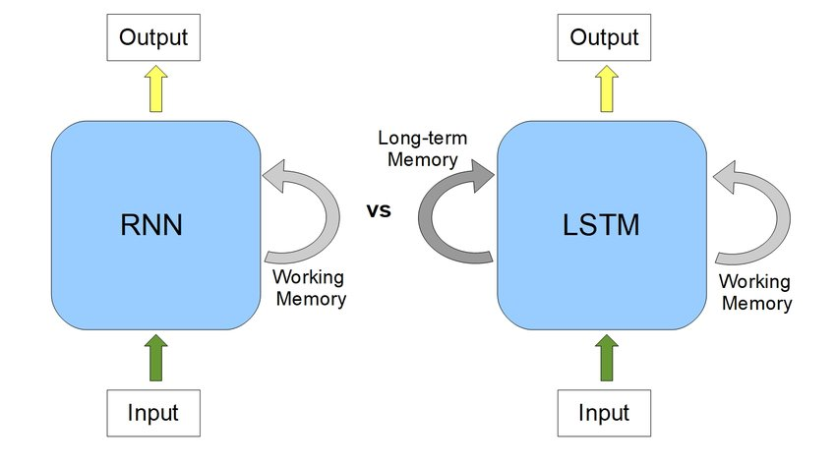
LONG SHORT-TERM MEMORY MODEL (LSTM)
LSTM is a type of Recurrent Neural Network.
It is effective in handling sequential data, such as stock prices.
RNN faces ‘Vanishing/Exploding Gradient’ when data is too large.
With the help of LSTM ‘Vanishing/Exploding Gradient’ is avoided.
It remembers information over long periods.

Slide 20
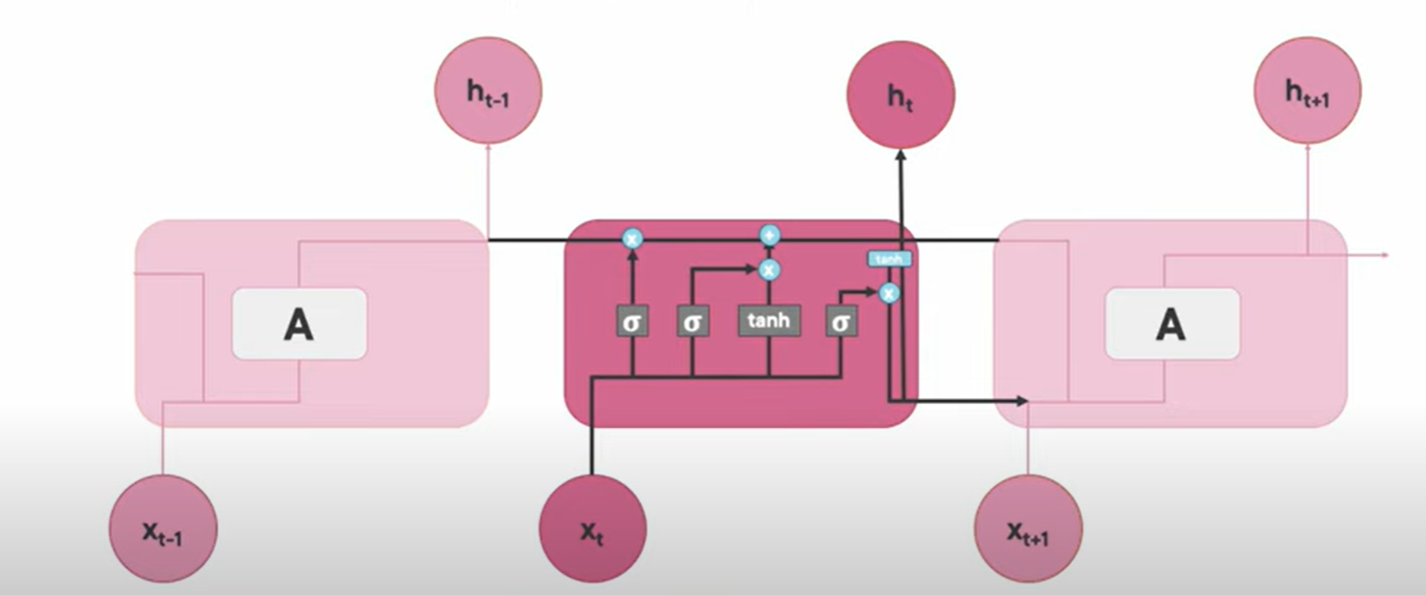
LSTM Architecture

Slide 21
LSTM
Epochs : 10
Window Size : 60
Loss : mean_squared_error
Optimizer : adam optimizer
Forecast : Next 100 days

Slide 22
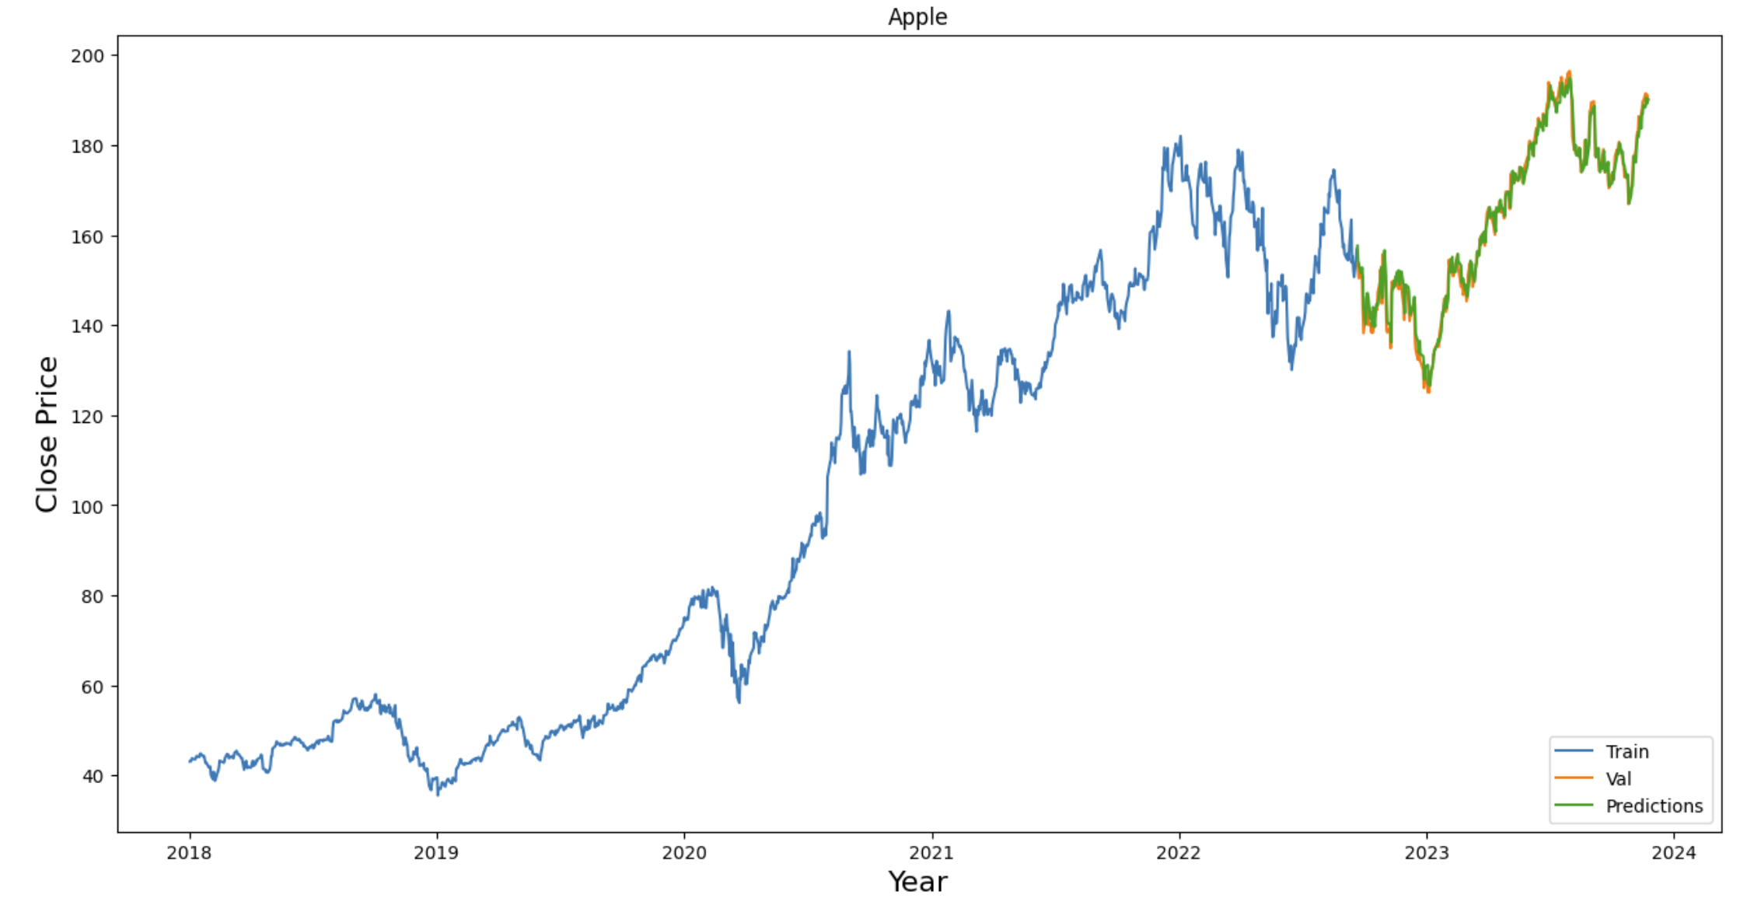
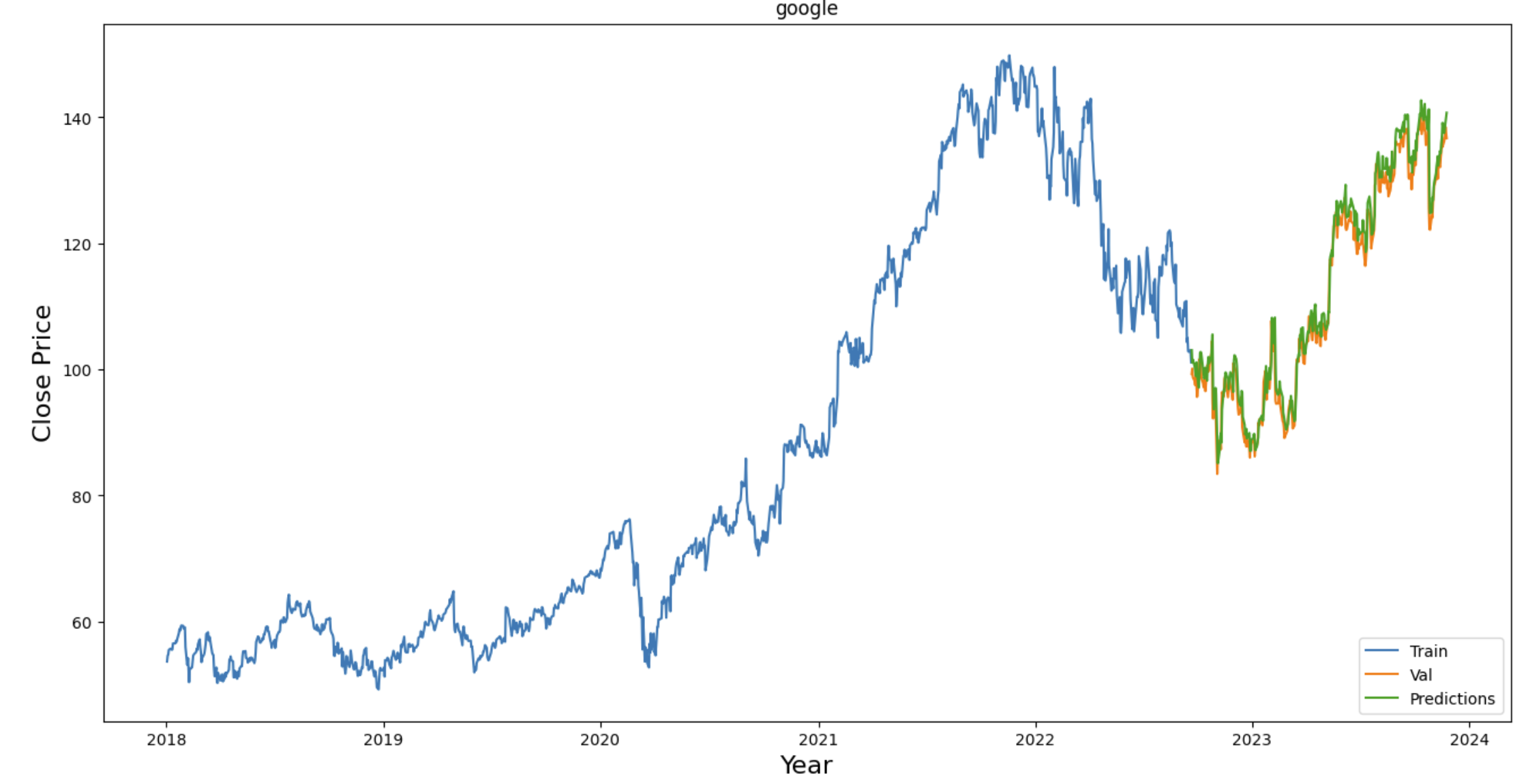
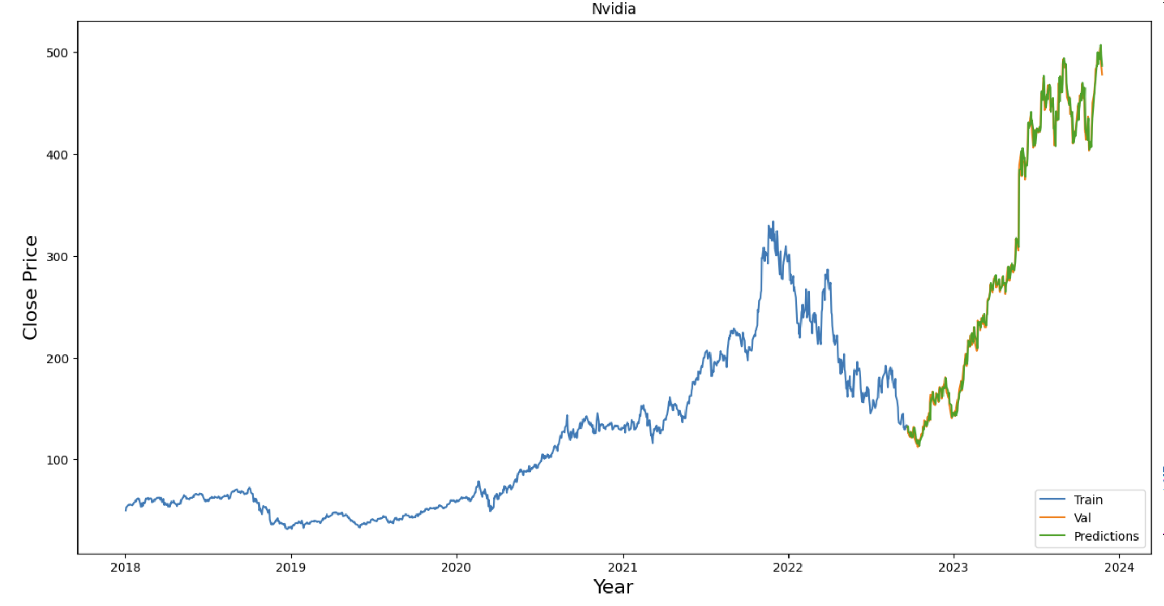
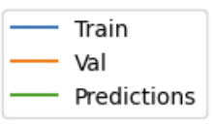
LSTM Predictions
Apple
Google
Nvidia

Slide 23
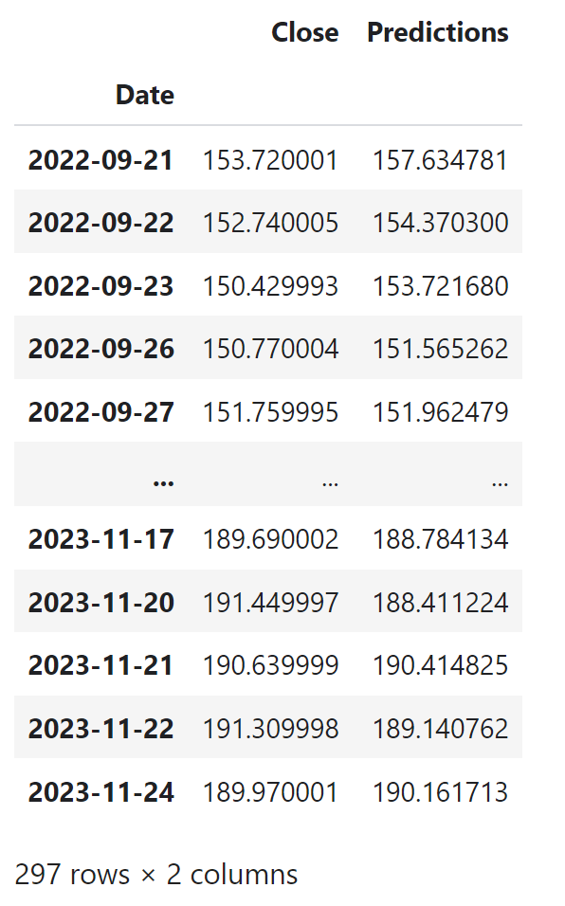
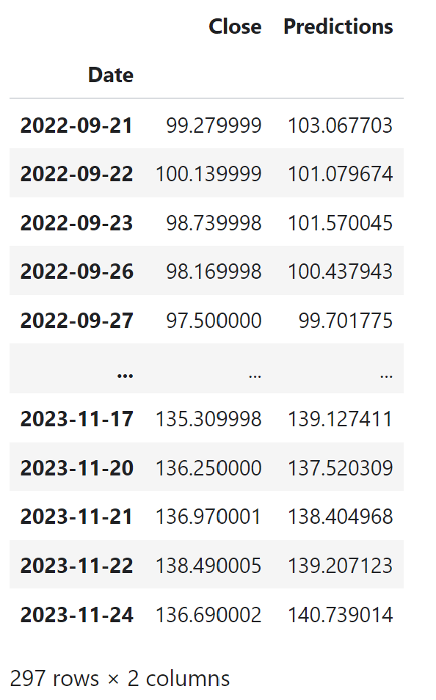
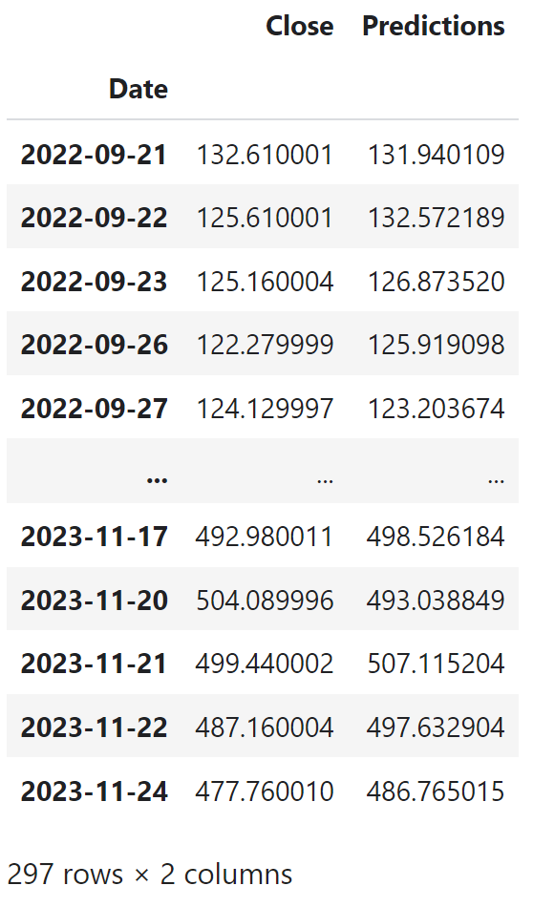
Actual vs Predicted
Google
Nvidia
Apple

Slide 24
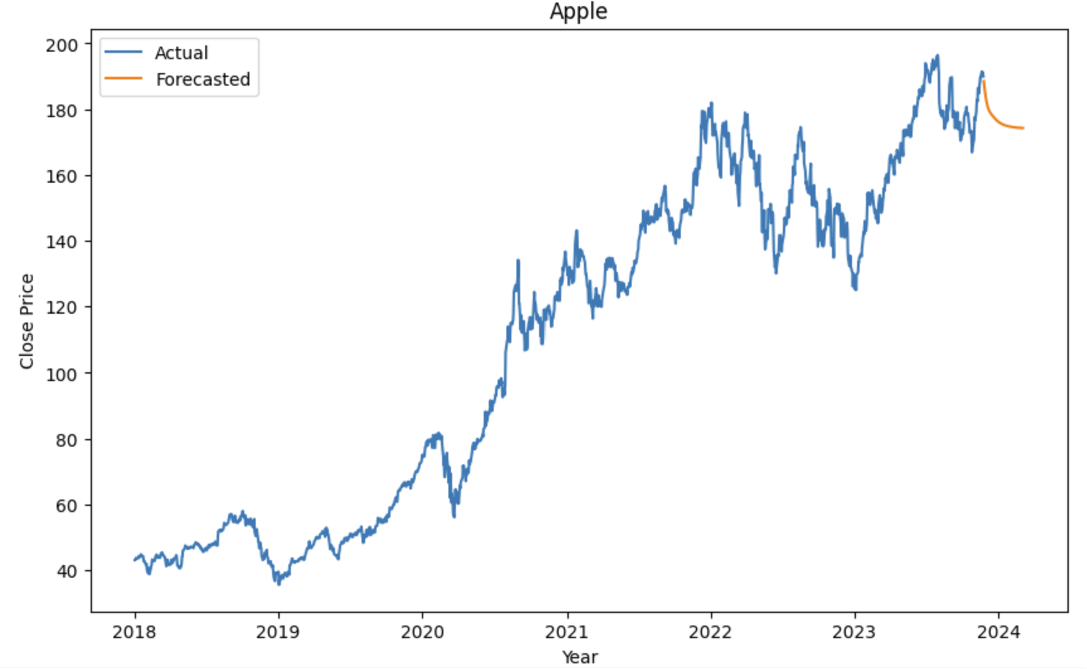
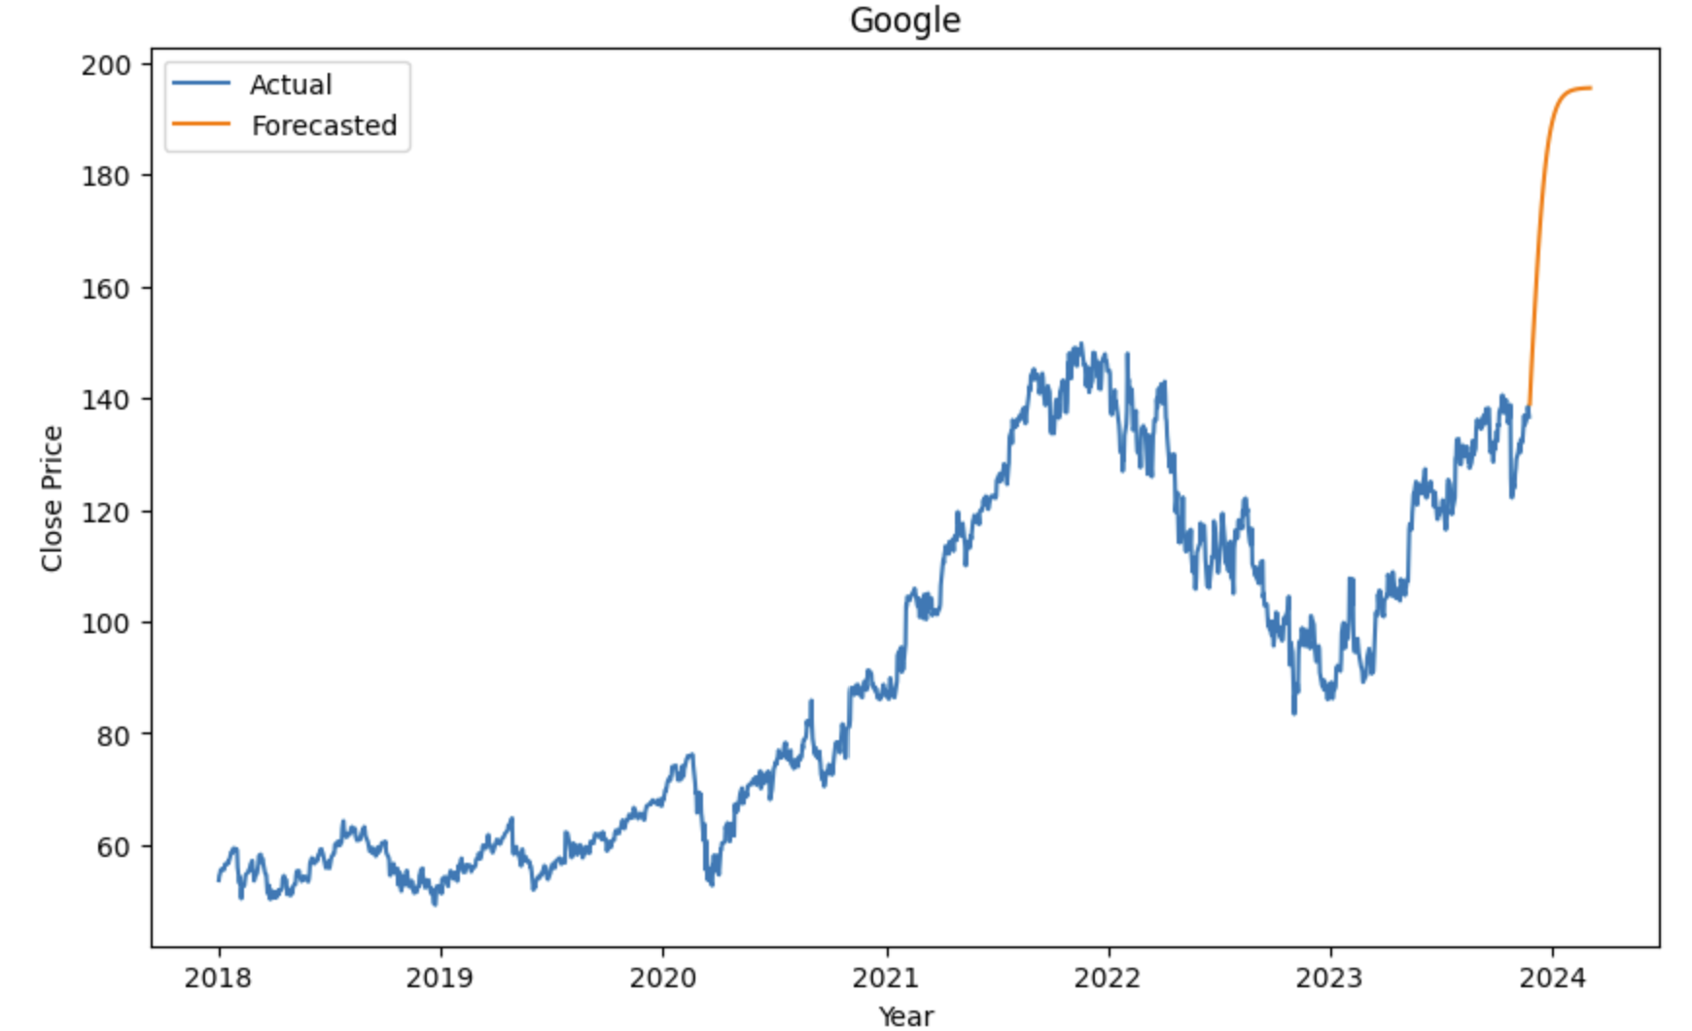
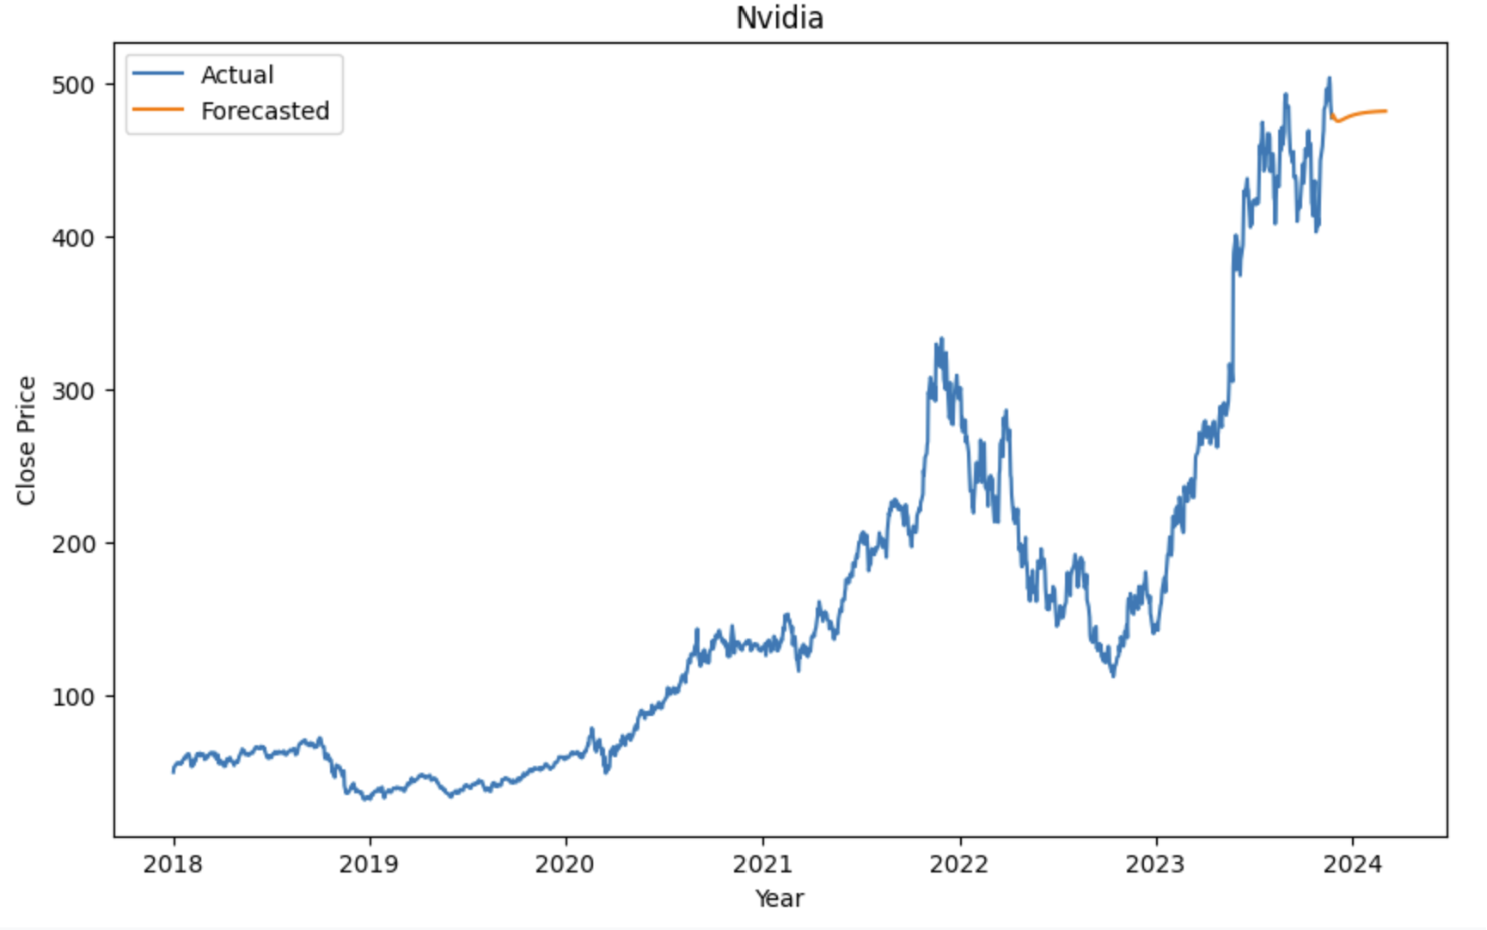
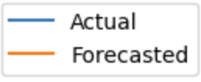
LSTM Forecast
Apple
Google
Nvidia

Slide 25
LSTM RMSE
Stock | RMSE
Apple | 2.658
Google | 2.821
Nvidia | 9.436

Slide 26
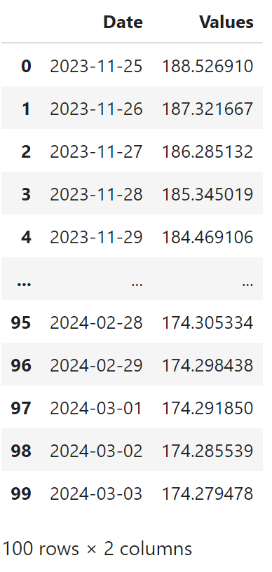
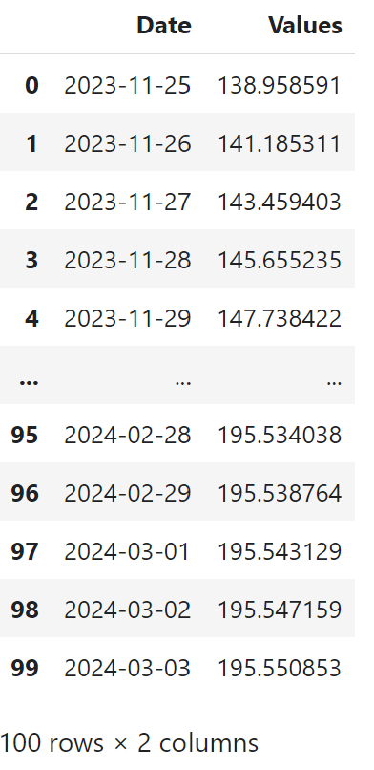
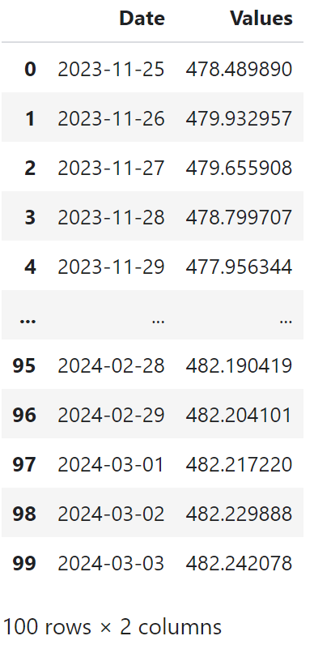
Forecasted Value
Apple
Google
Nvidia

Slide 27
MODEL COMPARISON: EVALUATING PERFORMANCE ACROSS FORECASTING ALGORITHMS
 | LINEAR REGRESSION MODEL | MOVING AVERAGE MODEL | LONG SHORT-TERM MEMORY MODEL
RMSE - APPLE | 11.342 | 26.804 | 2.658
RMSE – GOOGLE | 5.187 | 28.890 | 2.821
RMSE - NVIDIA | 188.026 | 223.928 | 9.436

Slide 28

DEMO

Slide 29

REFERENCES
Bland, G. (2020, November 3). yfinance Library – A Complete Guide. AlgoTrading101 Blog. https://algotrading101.com/learn/yfinance-guide/
(2023, May 1). Stock prices prediction using machine learning and Deep Learning. Analytics Vidhya. Retrieved October 1, 2023, from https://www.analyticsvidhya.com/blog/2018/10/predicting-stock-price-machine-learningnd-deep-learning-techniques-python/
A.Moghar, M.Hamiche,"Stock Market Prediction Using LSTM Recurrent Neural Network", Procedia Computer Science,Volume 170,2020,Pages 1168-1173
S. Kumar S, C. D and S. Rajan, "Stock price prediction using deep learning LSTM (long short-term memory)," 2022 2nd International Conference on Advance Computing and Innovative Technologies in Engineering (ICACITE), Greater Noida, India, 2022, pp. 1787-1791

Slide 30

REFERENCES
5. Gianluca Malato(2020, June 23). An algorithm to find the best moving average for stock trading. https://towardsdatascience.com/an-algorithm-to-find-the-best-moving-average-for-stock-trading-1b024672299c
6. Debasish Kalita (March 24th, 2022). An Overview on Long Short Term Memory (LSTM). https://www.analyticsvidhya.com/blog/2022/03/an-overview-on-long-short-term-memory-lstm/#:~:text=Structure%20Of%20LSTM&text=The%20flow%20of%20information%20into,time%20series%20of%20uncertain%20duration.
7. Dr. Suresh Subramanian1 , Sai Saketh Reddy, “STOCK MARKET PREDICTION SYSTEM USING ML”,JOURNAL OF EDUCATION: RABINDRA BHARATI UNIVERSITY, Vol: XXIV, No. :1(II), 2022, Pages 155-159.
8. (n.d.). Stock Price Prediction & Forecasting with LSTM Neural Networks in Python. Youtube. https://www.youtube.com/watch?v=CbTU92pbDKw

Slide 31

Thank you

